Slide 1
Tomcat Server, Conf & Servlet Basics

Slide 2
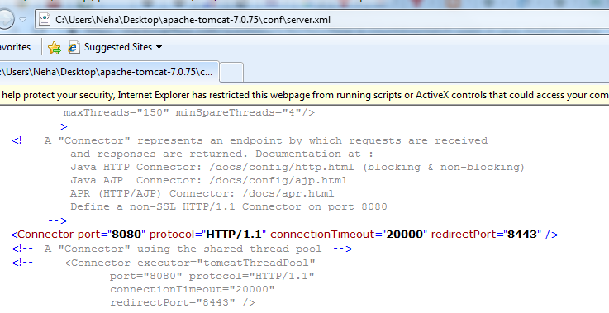
Server.xml (under Tomcat/conf folder)
It has default settings of tomcat . Like security https post no 8443 , default port 8080 etc.

